Slide 1
EXPERIMENTAL DESIGN AND PANDAS
Doug Friedman

Slide 2
TODAY’S LEARNING OBJECTIVES
EXPERIMENTAL DESIGN AND PANDAS
Define a problem and types of data
Identify data set types
Define the data science workflow
Apply the data science workflow in the pandas context
Create an IPython Notebook to import, format, and clean using the Pandas library

Slide 3
COURSE
PRE-WORK

Slide 4
PRE-WORK REVIEW
Create and open an IPython Notebook
Complete the Python pre-work

Slide 5
OPENING
EXPERIMENTAL DESIGN AND PANDAS

Slide 6
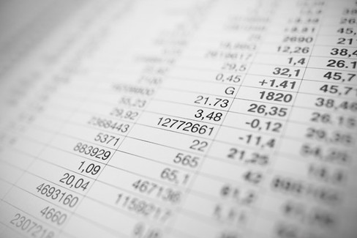
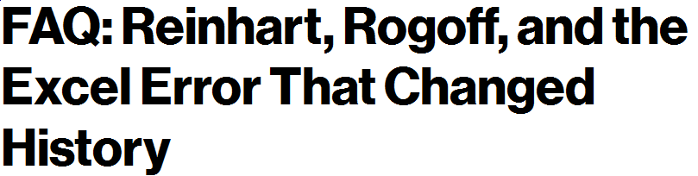
WHAT IS EXPERIMENTAL DESIGN (AND WHY SHOULD I CARE)?
“Our goal is always to actively design an experiment that has the best chance to produce meaningful, defensible evidence, rather than hoping that good statistical analysis may be able to correct for defects after the fact.”
- Howard Seltman

Slide 7
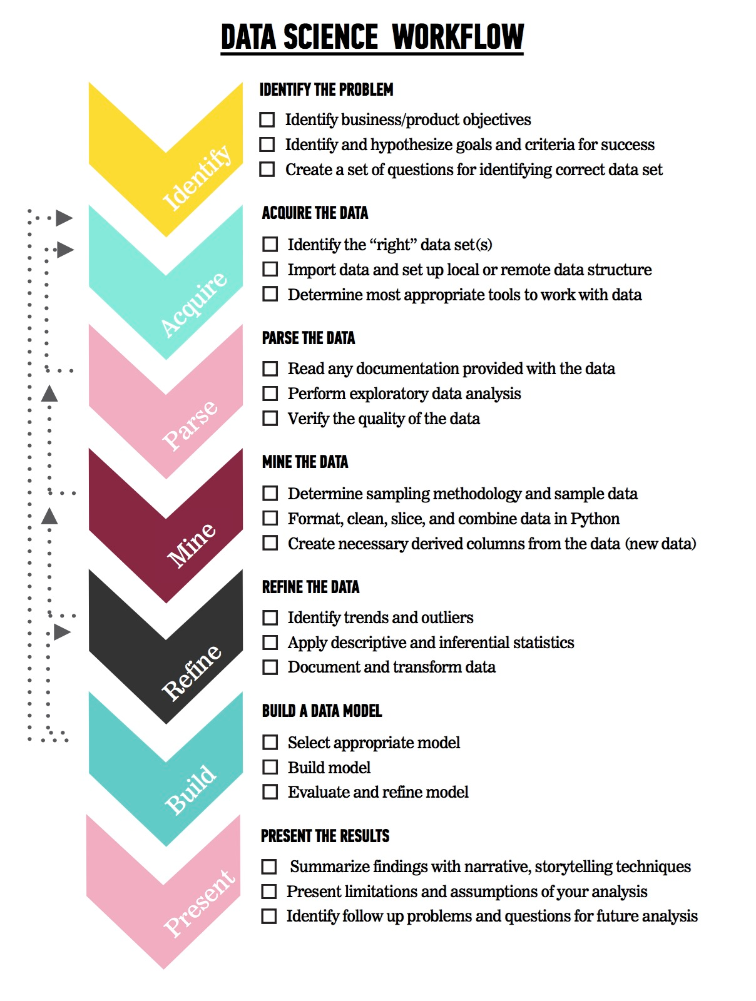
LET’S REVIEW THE DATA SCIENCE WORKFLOW
The steps:
Identify the problem
Acquire the data
Parse the data
Mine the data
Refine the data
Build a data model
Present the results

Slide 8
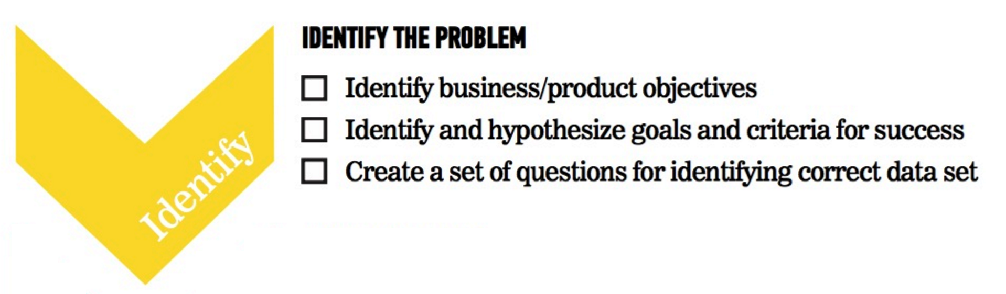
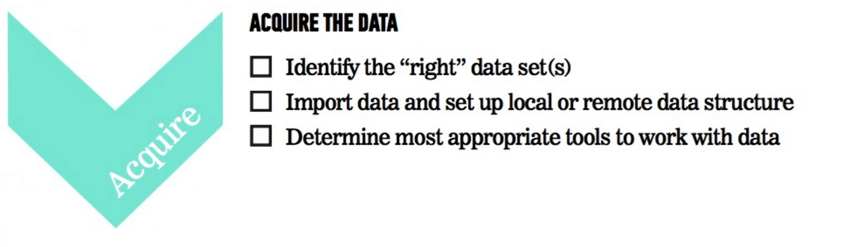
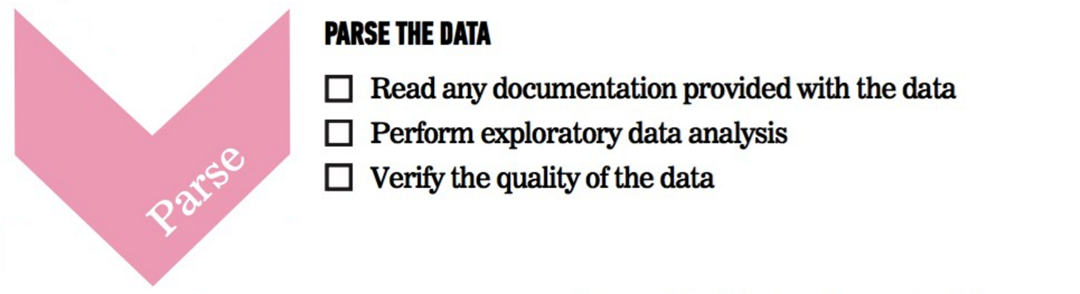
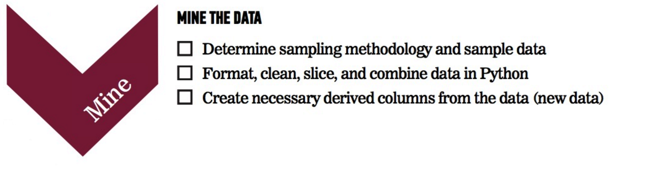
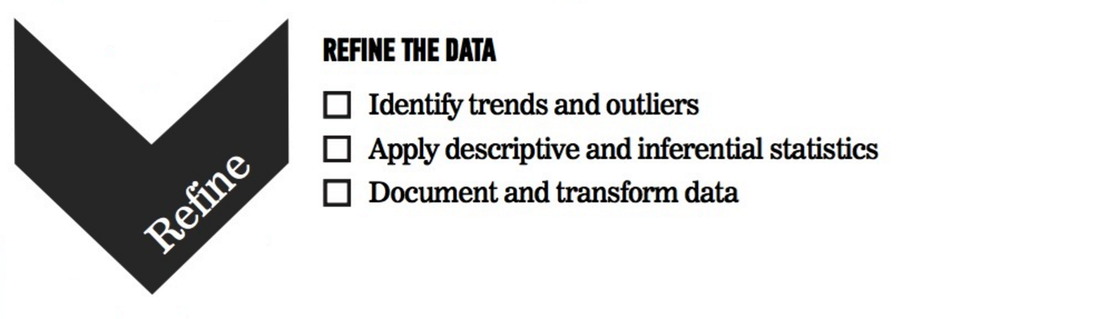
TODAY
We’re going to focus on steps 1-2 (Identify the Problem and Acquire the Data).
We’ll cover steps 3-5 in the next few classes

Slide 9
INTRODUCTION
ASKING A GOOD QUESTION

Slide 10
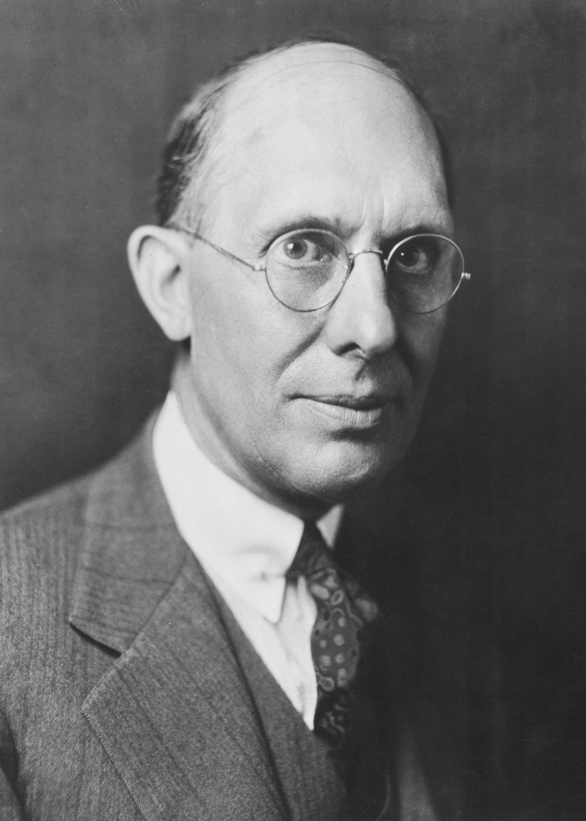
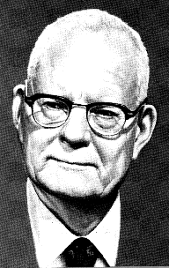
WHY DO WE NEED A GOOD QUESTION?
“A problem well stated is half solved.”
-Charles Kettering
“If you do not know how to ask the right question, you discover nothing.”
- W. Edward Deming

Slide 11
WHY DO WE NEED A GOOD QUESTION?
We need a good question because…
Defining the scope for a problem makes it manageable
It forces you to think about the nature of the problem
A clear statement of goals is key for collaboration with others
It acts as an anchor if the analysis gets off track

Slide 12
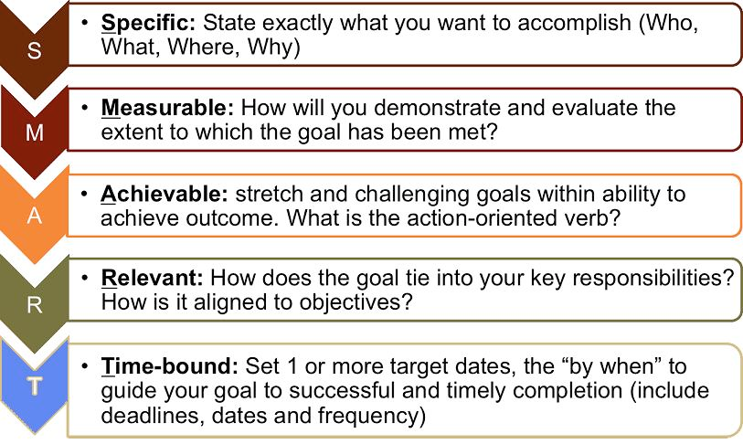
WHAT IS A GOOD QUESTION?
Goals are similar to the SMART Goals Framework.
S: specific
M: measurable
A: attainable
R: reproducible
T: time-bound

Slide 13
WHAT IS A GOOD QUESTION?
Specific: The dataset and key variables are clearly defined.
Measurable: The type of analysis and major assumptions are articulated.
Attainable: The question you are asking is feasible for your dataset and is not likely to be biased.
Reproducible: Another person (or future you) can read and understand exactly how your analysis is performed.
Time-bound: You clearly state the time period and population for which this analysis will pertain.

Slide 14
WHAT IS A GOOD QUESTION?

Slide 15
DEMO
DIAGRAMMING AN AIM

Slide 16

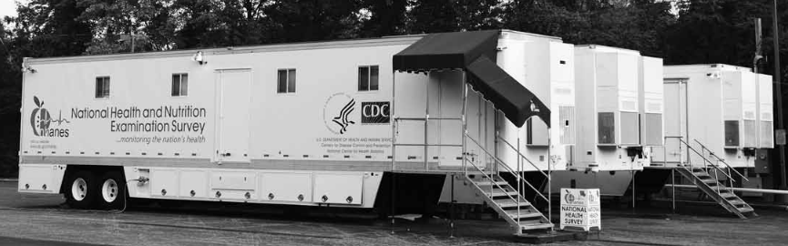
EXAMPLE DATASET
National Health and Nutrition Examination Survey (NHANES) “is a program of studies designed to assess the health and nutritional status of adults and children in the United States. The survey is unique in that it combines interviews and physical examinations” (http://www.cdc.gov/nchs/nhanes/).
It is regularly administered by the Centers for Disease Control and Prevention (CDC).

Slide 17
YOUR TURN
What issues are we going to face when selecting an aim for a large dataset like NHANES?
What are some strategies that we could use to avoid or manage these issues?

Slide 18
EXAMPLE AIM
Determine the association of foods in the home with child dietary intake.
Using data from one 24-hour period from the NHANES 2010-2011, we will determine the factors associated with food available in the homes of American children and adolescents.
We will test if reported availability of fruits, dark green vegetables, low fat milk or sugar sweetened beverages available in the home increases the likelihood that children and adolescents will meet their USDA recommended dietary intake for that food.

Slide 19

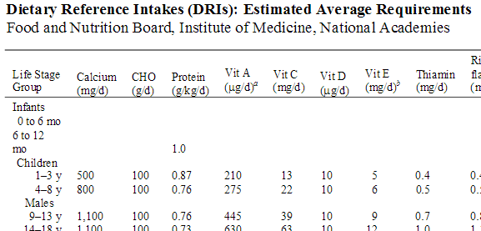
EXAMPLE HYPOTHESIS
Children will be more likely to meet the USDA recommended intake level when food is always available in their home compared to rarely or never.

Slide 20
SPECIFIC
How data was collected:
Over a 24-hour period, self-reported
What data was collected:
Fruits, dark green vegetables, low fat milk or sugar sweetened beverages, always vs. rarely available
How data will be analyzed:
Using USDA recommendations as a gold-standard to measure the association
The specific hypothesis (& direction) of the expected associations:
Children will be more likely to meet their recommended intake level

Slide 21
MEASURABLE
Determine the association of foods in the home with child dietary intake.
We will test if the reported availability of certain foods increases the likelihood that children and adolescents will meet their USDA recommended dietary intake for food.

Slide 22
ATTAINABLE
This data has inherent limitations - causal inference is not possible as we only have a single observation for each respondent associated with a single time (2010-2011).
Note that we are determining association, not causation.

Slide 23
REPRODUCIBLE
With all the specifics, it would be straightforward to pull the data from the NHANES website and reproduce the analysis.

Slide 24
TIME BOUND
Using one 24-hour period from NHANES 2010-2011, we will determine the factors associated with food available in the homes of American children and adolescents.

Slide 25
“CONTENT IS KING, BUT CONTEXT IS GOD.”
The previous example laid out research goals, but also provided ample details about the context of the problem.
In a business setting, you will not only need to articulate business objectives, but highlight the context surrounding them.
Example: Success for the Netflix recommendation engine may be if 70% of customers over the age of 18 select a movie from the recommended queue during Q3 of 2015.
Regardless of the setting, start your question with the SMART framework to help define and achieve your objectives.
Notes:
Quotation Source: https://www.garyvaynerchuk.com/content-is-king-but-context-is-god/

Slide 26

ACTIVITY: KNOWLEDGE CHECK
ANSWER THE FOLLOWING QUESTIONS (5 minutes)
EXERCISE
Which of the following uses the SMART framework? Why? What is missing?
I am looking to see if there is an association with number of passengers with carry on luggage and delayed take-off time.
Determine the if weather delays are associated with the winter season for flights arriving at Washington DC’s National Airport (DCA) from January 2015 – December 2015 using the Bureau of Transportation Statistics’ Airline On-Time Statistics (http://www.transtats.bts.gov/OT_Delay/OT_DelayCause1.asp).
DELIVERABLE
Answers to the above questions

Slide 27
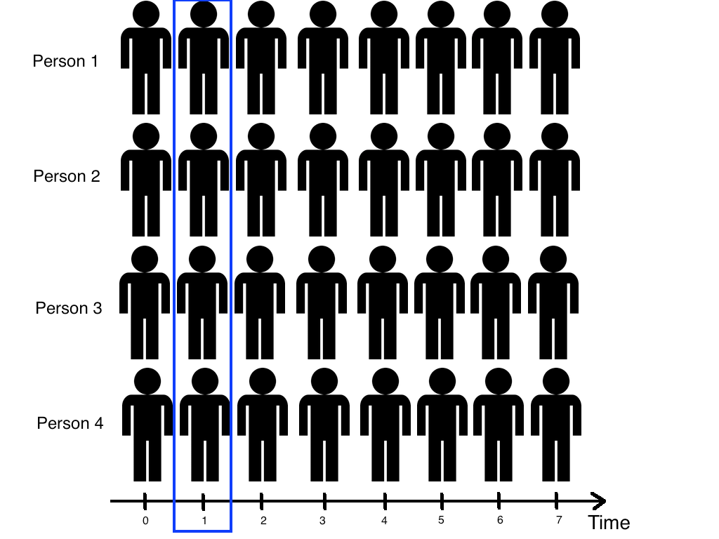
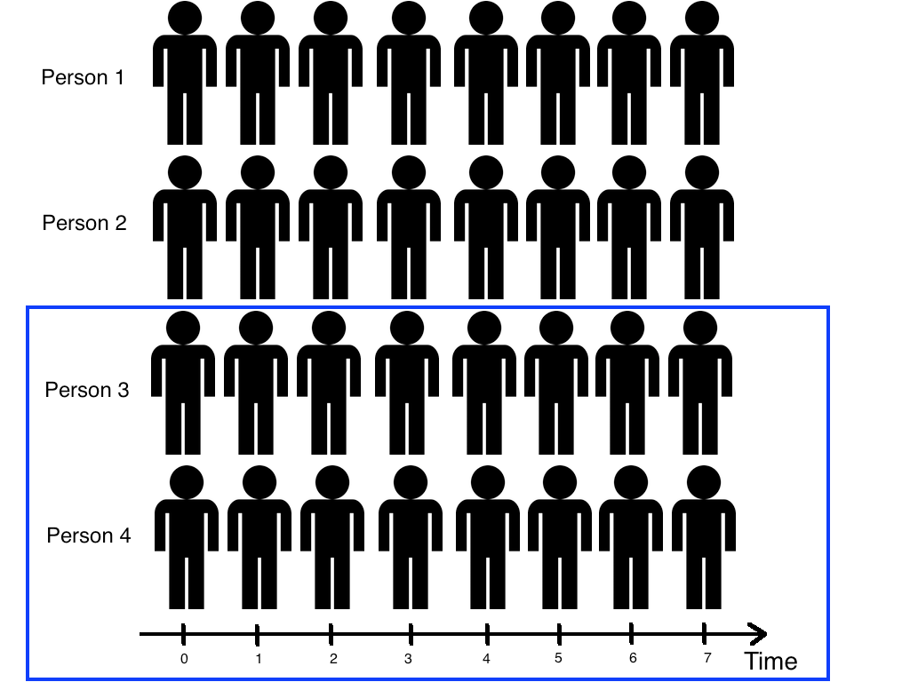
DIFFERENT TYPES OF DATA
There two major types of data: cross-sectional and time series/longitudinal.
CROSS-SECTIONAL
TIME SERIES/LONGITUDINAL

Slide 28
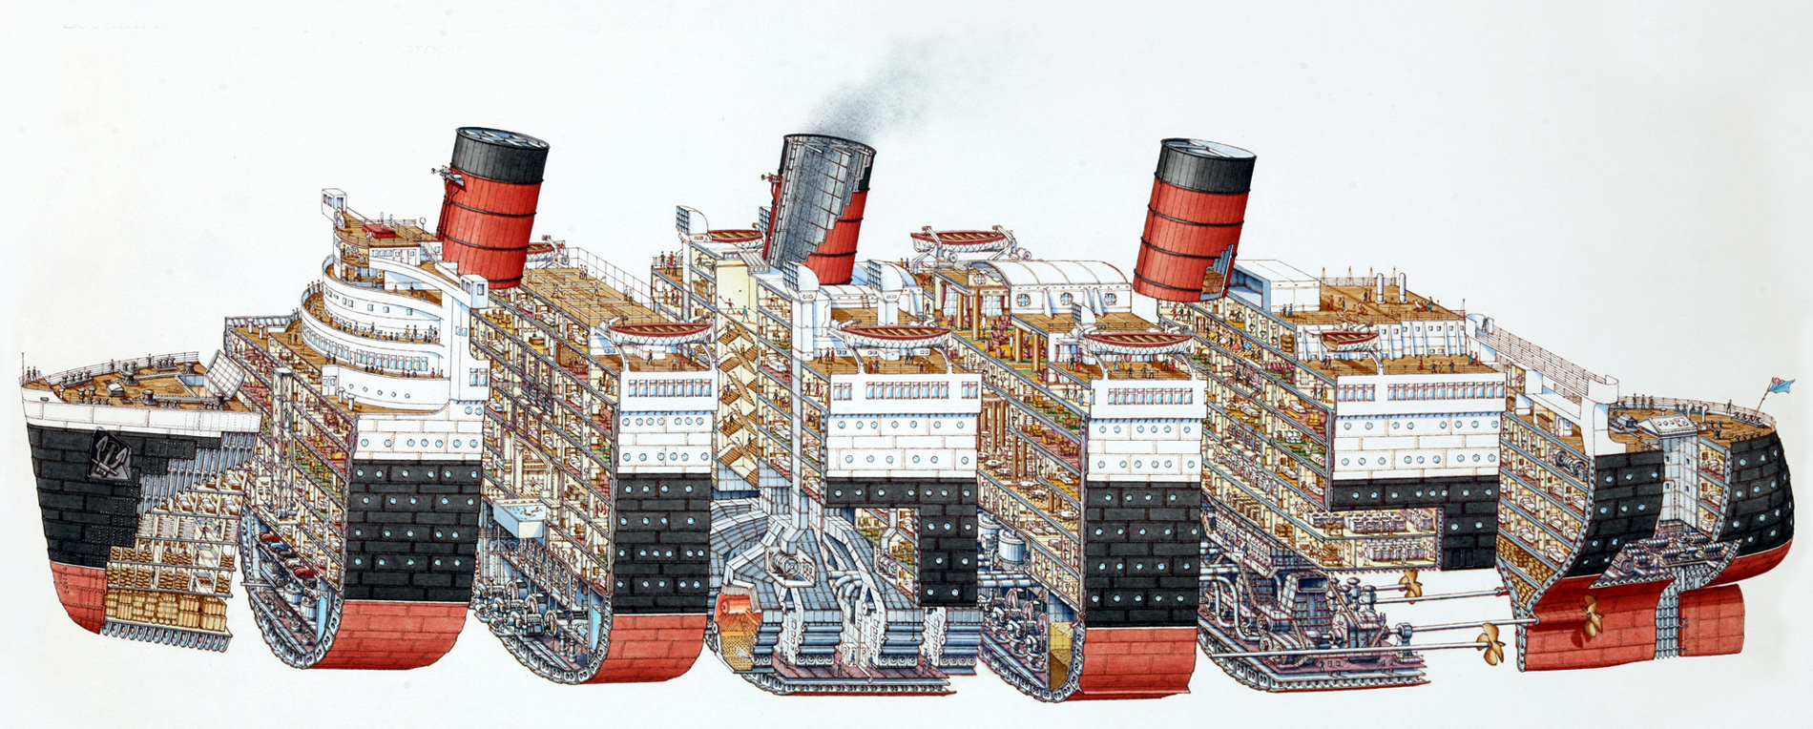
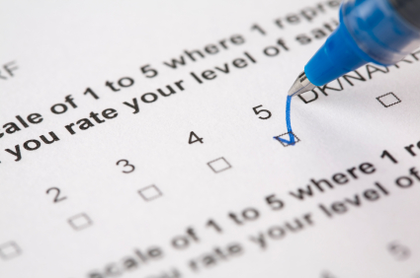
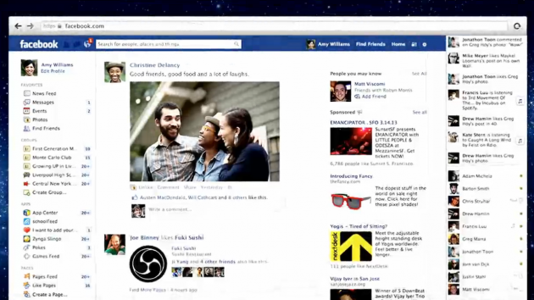
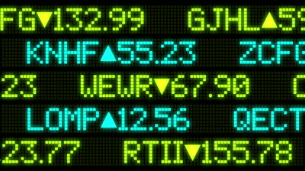
CROSS-SECTIONAL DATA
Cross-sectional data are information gathered at the exact same time representing a snapshot or slice of the information.
What are some examples of cross-sectional data?
Surveys
Facebook News Feed
Stock Crawl/Ticker

Slide 29
CROSS-SECTIONAL DATA
What are the strength of cross-sectional data?
It is normally based on a large, more representative population.
It is more affordable when compared to other types of data collection methods.
What are the weaknesses of cross-sectional data?
It can be difficult to establish causality given the limited amount of time represented.
Variables or observations with long duration are over-represented.

Slide 30

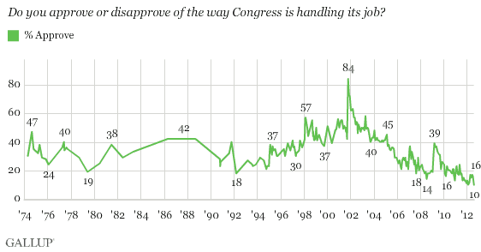
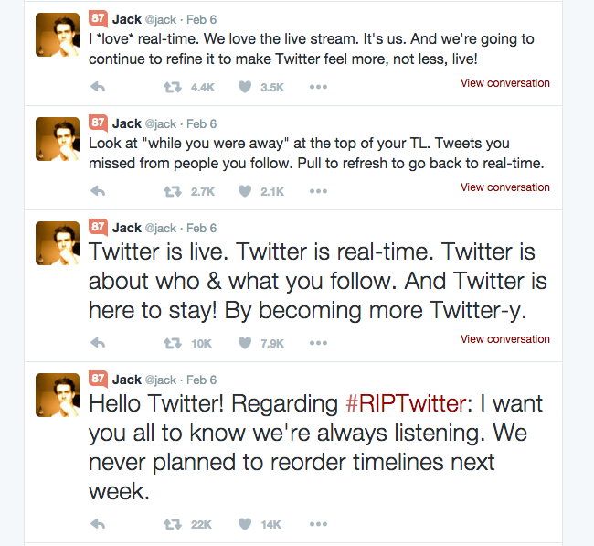
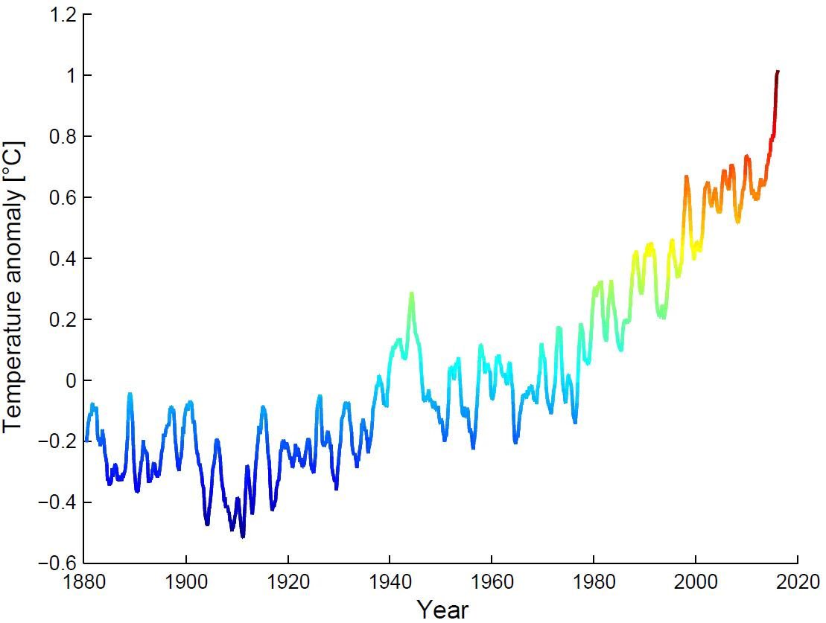
TIME SERIES/LONGITUDINAL DATA
Time Series/Longitudinal data are information repeatedly gathered over time about the subject.
What are some examples of time series/longitudinal data?
Polling
Twitter Timeline
Weather Observations

Slide 31
TIME SERIES/LONGITUDINAL DATA
What are the strength of time series/longitudinal data?
There is a clear sequence and structure to the data.
Multiple outcomes can be measured.
What are the weaknesses of time series/longitudinal data?
It is expensive and time-consuming to maintain.
It is especially prone to having missing or incomplete data.

Slide 32
ACTIVITY: KNOWLEDGE CHECK
ANSWER THE FOLLOWING QUESTIONS (5 minutes)
EXERCISE
What type of data is the delay data?
Determine the if weather delays are associated with the winter season for flights arriving at Washington DC’s National Airport (DCA) from January 2015 – December 2015 using the Bureau of Transportation Statistics’ Airline On-Time Statistics (http://www.transtats.bts.gov/OT_Delay/OT_DelayCause1.asp).
Can you create a cross-sectional analysis from a longitudinal data collection? How?
DELIVERABLE
Answers to the above questions

Slide 33
GUIDED PRACTICE
WRITE A RESEARCH QUESTION WITH RAW DATA

Slide 34
ACTIVITY: WRITE A RESEARCH QUESTION WITH RAW DATA
DIRECTIONS (10 minutes)
EXERCISE
Individually, look at the data from Kaggle’s Titanic competition and write a high quality research question.
Make sure you answer the following questions:
What type of data is this, cross-sectional or longitudinal?
What will we be measuring?
What is the SMART aim for this data?
When finished, split into pairs and share your answers with each other.
DELIVERABLE
Research Question

Slide 35
REVIEW
SMART

Slide 36
SMART REVIEW
The SMART framework covers the “Identify” step of the data science workflow.
Types of datasets: cross-sectional vs. time series/longitudinal
Questions?

Slide 37
INTRODUCTION
DATA SCIENCE WORKFLOW: ACQUIRE & PARSE

Slide 38
DATA SCIENCE WORKFLOW: ACQUIRE & PARSE
For the remainder of class, we’ll talk about steps 2 & 3 of the data science workflow: acquire and parse.
We’ll do a demo and then a code along using IPython Notebook.
Finally, we’ll wrap up with a lab where everyone will get some hands-on practice with these concepts.

Slide 39
DEMO
WALKTHROUGH ACQUIRE & PARSES WITH PANDAS

Slide 40
ACQUIRE
We’ll determine if we have the “right” dataset for our problem.
Questions to ask:
What type of data is it, cross-sectional or longitudinal?
How well was the data collected?
Is there much missing data?
Was the data collection instrument validated and reliable?
Is the dataset aggregated?
Do we need pre-aggregated data?

Slide 41
LOGISTICS OF ACQUIRING YOUR DATA
Data can be acquired through a variety of sources such as:
Web (e.g. Websites, Google Analytics)
Flat Files (e.g. CSV, XLSX, XML, TXT, JSON)
Databases (e.g. SQL, NOSQL, etc)
Today, we’ll be using a CSV (comma separated file).

Slide 42
PARSE: UNDERSTANDING YOUR DATA
We’ll focus on better understanding the data you’ve chosen by…
Creating or reviewing the data dictionary (if one exists)
Performing exploratory analysis
Describing the structure of the data
Exploring each variable and how they store information (e.g. categorical vs continuous)

Slide 43
INTRO TO DATA DICTIONARIES AND DOCUMENTATION
Data dictionaries are key to understanding both the big picture and details of data such as how the information was collected or how a specific variables was coded (e.g. Is the currency dollars or euros?).
Data dictionaries help identify any requirements, assumptions, and constraints of the data.
They make it easier to share data and give an opportunity for the data owners to give guidance to users looking to analyze it.

Slide 44
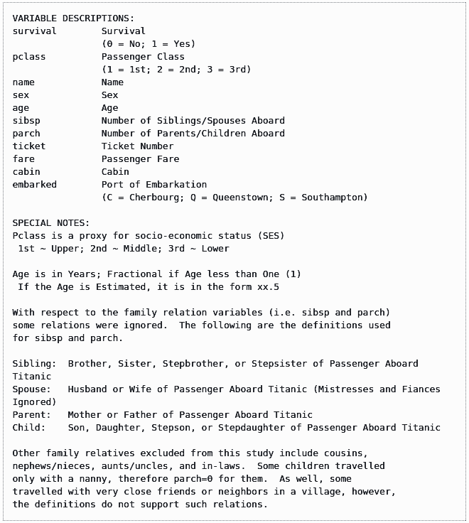
DATA DICTIONARY EXAMPLE: KAGGLE TITANIC DATA

Slide 45
CODEALONG
NUMPY AND PANDAS INTRO

Slide 46
NUMPY AND PANDAS INTRO
NumPy is a package for Python that adds a lot of helpful mathematical and scientific computing functionality (e.g. linear algebra).
It also introduces a new data structure called an array which is a modified version of a traditional list to make math operations easier to work with.
Pandas is a package for Python that provides a ton of new functionality related to data analysis (e.g. reading in data files, organizing data).
It introduces a new data structure called a DataFrame which is Python’s version of an Excel workbook or SQL database table.

Slide 47
DEMO
LAB WALKTHROUGH

Slide 48
LESSON 2 LAB WALKTHROUGH
In this lab, you will work with a dataset containing weather information called ozone.
By the end of the lab, you will be able to:
Check basic features of the data
Find and drop missing values
Find basic stats like mean and max

Slide 49
CONCLUSION
TOPIC REVIEW

Slide 50
REVIEW
Let’s go through the lab. Any questions?
Today, we’ve talked about
Defining a problem
Types of data
Acquiring and parsing data
Using Pandas

Slide 51
COURSE
BEFORE NEXT CLASS

Slide 52
DUE DATE
BEFORE NEXT CLASS
Review Unit Project 1 and consider starting it now. We will not be covering all of the material until the next class, but we have covered enough for you to get started.

Slide 53
LESSON
Q & A

Slide 54
LESSON
EXIT TICKET
DON’T FORGET TO FILL OUT YOUR EXIT TICKET

